Slide 1
UNIT IV
TRANSIENT STATE STABILITY ANALYSIS

Slide 2
STABILITY
The tendency of a power system to develop restoring forces equal to or greater than the disturbing forces to maintain the state of equilibrium.
Ability to keep the machines in synchronism with another machine
1

Slide 3
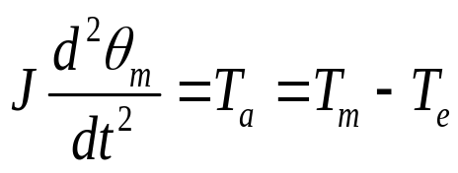

Swing Equation
The equation governing the motion of the rotor of a synchronous machine
where
J=The total moment of inertia of the rotor(kg-m²)
=Singular displacement of the rotor
T_{m}=Mechanical torque (N-m)
T_{e}=Net electrical torque (N-m)
T_{a}=Net accelerating torque (N-m)

Slide 4
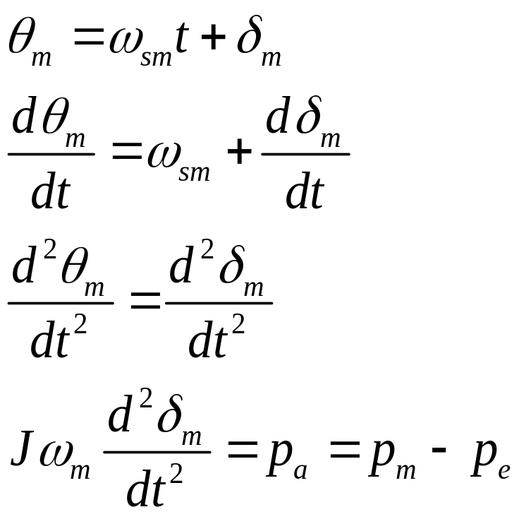
Where p_{m} is the shaft power input to the machine
p_{e} is the electrical power
p_{a} is the accelerating power

Slide 5
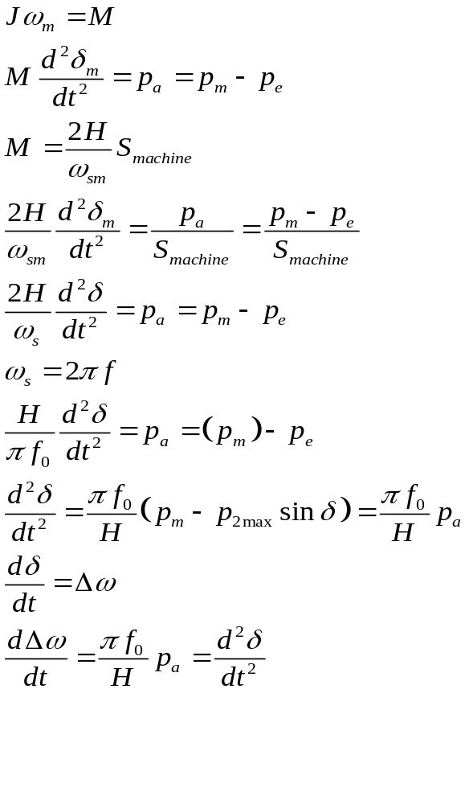
H=machine inertia constant
p.u
δ and ω_{s} are in electrical radian
p.u

Slide 6

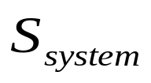
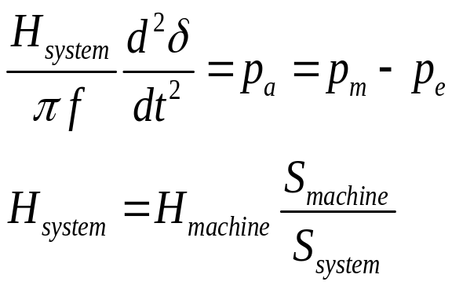
Swing Equation for Multimachine System
=machine rating(base)
=system base
p.u

Slide 7
Equal Area Criterion
This is a simple graphical method to predict the transient stability of two machine system or a single machine against infinite bus.
This criterion does not require swing equation or solution of swing equation to determine the stability condition.
The stability conditions are determined by equating the areas of segments on power angle diagram.

Slide 8
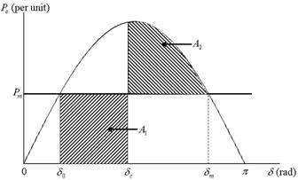


Power-angle curve for equal area criterion
multiplying swing equation by on both sides
Multiplying both sides of the above equation by dt and then integrating between two arbitrary angles δ₀ and δ_{c}

Slide 9



Once a fault occurs, the machine starts accelerating. Once the fault is cleared, the machine keeps on accelerating before it reaches its peak at δ_{c} ,
The area of accelerating A1
The area of deceleration is given by A₂
If the two areas are equal, i.e., A₁ = A_{2,} then the power system will be stable

Slide 10



Critical Clearing Angle (δ_{cr}) maximum allowable value of the clearing time and angle for the system to remain stable are known as critical clearing time and angle.
δ_{cr} expression can be obtained by substituting δ_{c} = δ_{cr} in the equation A1 = A2
Substituting P_{e} = 0 in swing equation
Integrating the above equation

Slide 11


Replacing δ by δ_{cr} and t by t_{cr} in the above equation, we get the critical clearing time as

Slide 12
Factors Affecting Transient Stability
Strength of the transmission network within the system and of the tie lines to adjacent systems.
The characteristics of generating units including inertia of rotating parts and electrical properties such as transient reactance and magnetic saturation characteristics of the stator and rotor.
Speed with which the faulted lines or equipments can be disconnected.

Slide 13
Numerical Integration methods
Modified Euler’s method
Runge-Kutta method

Slide 14
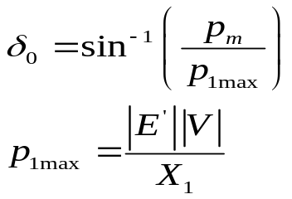
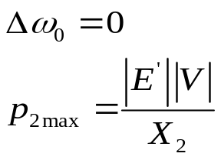
Numerical Solution of the swing equation
Input power p_{m}=constant
At steady state p_{e}=p_{m},
At synchronous speed

Slide 15
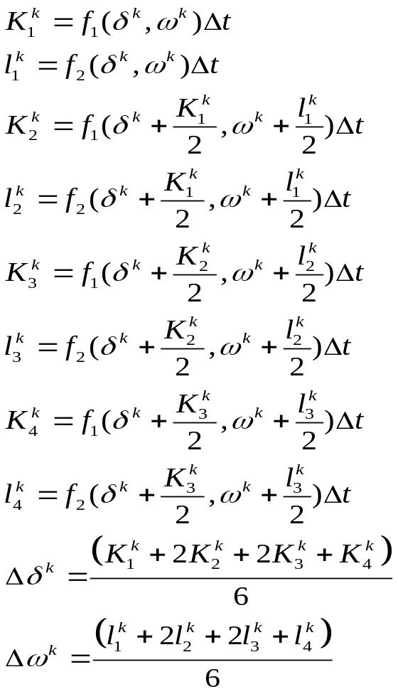
Runge-Kutta Method
Obtain a load flow solution for pretransient conditions
Calculate the generator internal voltages behind transient reactance.
Assume the occurrence of a fault and calculate the reduced admittance matrix
Initialize time count K=0,J=0
Determine the eight constants

Slide 16
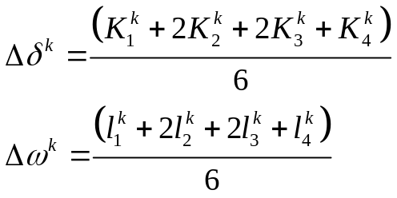
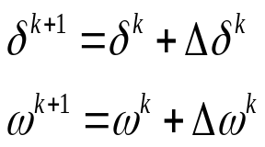
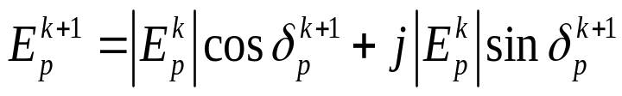
Compute the change in state vector
Evaluate the new state vector
Evaluate the internal voltage behind transient reactance using the relation
Check if t<t_{c} yes K=K+1
Check if j=0,yes modify the network data and obtain the new reduced
admittance matrix and set j=j+1
set K=K+1
Check if K<Kmax, yes start from finding 8 constants

Slide 17
Methods to improve Stability
Use of Bundled Conductors
Use of Double-Circuit Lines
Operate Transmission Lines in Parallel
Series Compensation of the Lines
Series Compensation of the Lines
High-Speed Excitation Systems
Fast Switching
Breaking Resistors
Single-Pole Switching
HVDC Links
Load Shedding

